Slide 1
Linked lists
Lecture 2……..cont’ed

Slide 2
Linked lists
a linked list is a linear list that stores a collection of data elements.
A linked list can be viewed as a group of items, each of which points to the item in its neighbourhood.
A linked list is a sequence of one or more nodes together with a set of operations.
An item in a linked list is known as a node. A node contains a data part and one or two pointer part which contains the address of the neighbouring nodes in the list.
Linked list is a data structure that supports dynamic memory allocation and hence it solves the problems of using an array.

Slide 3
Dynamic Memory Allocation
To overcome wastage of memory space, we need to dynamically allocate memory according to user input. We can do this using pointers and C’s inbuilt functions malloc() and calloc ().
The calloc() and malloc () are system functions that dynamically allocates a block of memory at runtime (during program execution) from the heap and returns a pointer to the new block.
The difference between the two is that malloc takes one argument while calloc takes two. Unlike malloc, with calloc, the initial memory contents is filled with zero.
An opposite of malloc and calloc is free() function used to free the allocated memory.

Slide 4
Cont’ed
The linked list is a very flexible dynamic data structure: items may be added to it or deleted from it at will.
An array (linear list) allocates memory for all its elements lumped together as one block of memory.
In contrast, a linked list allocates space for each element separately in its own block of memory called a "linked list element" or "node".
The list gets its overall structure by using pointers to connect all its nodes together like the links in a chain.

Slide 5
Cont’ed
Each node contains two fields: a "data" field to store whatever element type the list holds for its client, and a "next" field, which is a pointer used to link one node to the next node.
diagram
Head

Slide 6
Cont’ed
A linked list is a series of connected nodes.
Each node contains at least:
A piece of data (any type)
Pointer to the next node in the list
Head: pointer to the first node.
The last node points to NULL.
A node is a data structure cell that contains two fields; an element(item, data, information) field and a next (link, pointer) field that holds data/information and pointer to the next node in the list respectively.
Diagram…..Node

Slide 7
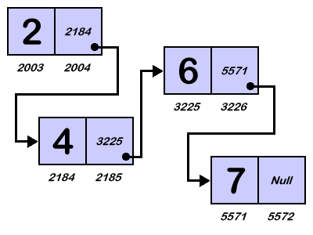

Cont’ed
In the example below, notice that the last node contains the symbol called "Null". This is a special value that tells us that we have reached the end of our list.
header

Slide 8
N/B
The name of linked list is just a pointer to the first node.
The end of a linked list is indicated by a diagonal line (/) or a period (.) in the next field of the last node.

Slide 9
advantages
Linked lists have certain advantages over arrays because it is not necessary to impose a restrictions on the list size. This allows us to write robust programs which require much less maintenance .i.e. An array is of fixed size (unless it is dynamically allocated), a linked list can grow by grabbing new memory off the heap as needed.
The list elements can easily be inserted or removed without reallocation or reorganization of the entire structure because the data items need not be stored contiguously in memory or on disk. Linked lists allow insertion and removal of nodes at any point in the list, and can do so with a constant number of operations if the link previous to the link being added or removed is maintained during list traversal.

Slide 10
advantages
The storage locations for dynamic variable can be created and destroyed as a program executes.
The pointer variable is used to store the address where the data for the dynamic variable is stored.
Dynamic variables are powerful because they make possible a system of storing the address where information is stored rather than storing information directly.
If the information stored in the dynamic variable is no longer needed the procedure delete or dispose can be used to dispose off a dynamic variable and free the storage locations for other information.

Slide 11
Types of linked lists
The different types of linked lists include:
Singly linked lists
Circular linked lists
Doubly linked lists
Simple/Singly Linked Lists
In singly linked lists, each node contains a data part and an address part. The address part of the node points to the next node in the list.
Node Structure of a linked list
Data part
Link part

Slide 12
Cont’ed
Possible Operations on a singly linked list
Insertion: Elements are added at any position in a linked list by linking nodes.
Deletion: Elements are deleted at any position in a linked list by altering the links of the adjacent nodes.
Searching or iterating through the list to display items.
To insert or delete items from any position of the list, we need to traverse the list starting from its root till we get the item that we are looking for.

Slide 13
Doubly Linked List
In doubly linked list, each node contains, besides the next-node link, a second link field pointing to the previous node in the sequence. The two links may be called forward(s) and backwards, or next and prev(ious).
In a doubly linked list, each node has two links: one pointing to the previous node and one pointing to the next node.
A doubly linked list whose nodes contain three fields: an integer value, the link forward to the next node, and the link backward to the previous node
diagram-
Node structure and example

Slide 14
Cont’ed
Advantages
The next and previous elements may be accessed.
We can use a pointer to the cell containing the ith element of a list to represent position i .
Disadvantages
There is a price to pay for the additional pointer in the cell.
The procedures for the operation are lengthy.

Slide 15

Circular Linked Lists
In a circularly-linked list, the first and final nodes are linked together.
In another words, circularly linked lists can be seen as having no beginning or end.
To traverse a circular linked list, begin at any node and follow the list in either direction until you return to the original node.
This type of list is most useful in cases where you have one object in a list and wish to see all other objects in the list.
The pointer pointing to the whole list is usually called the end pointer.

Slide 16
Basic Operations on a Circular Linked List
Insert – Inserts a new element at the end of the list.
Delete – Deletes any node from the list.
Find – Finds any node in the list.
Print – Prints the list.

Slide 17
Advantages of circularly linked list
Every node is accessible from a given node.
Deletions are easier than in singly-linked linear lists.
Operations such as concatenation, splitting etc become more efficient in circularly linked list
Disadvantages
It is possible to get into an infinite loop if the end of the list is not properly detected

Slide 18
Singly-circularly-linked list
In a singly-circularly-linked list, each node has one link, similar to an ordinary singly-linked list, except that the link of the last node points back to the first node.
As in a singly-linked list, new nodes can only be efficiently inserted after a node we already have a reference to. For this reason, it's usual to retain a reference to only the last element in a singly-circularly-linked list, as this allows quick insertion at the beginning, and also allows access to the first node through the last node's next pointer.

Slide 19
Doubly-circularly-linked list
In a doubly-circularly-linked list, each node has two links, similar to a doubly-linked list, except that the previous link of the first node points to the last node and the next link of the last node points to the first node.
As in doubly-linked lists, insertions and removals can be done at any point with access to any nearby node.

Slide 20
Circularly-linked list vs. linearly-linked list
Circularly linked lists are useful to traverse an entire list starting at any point. In a linear linked list, it is required to know the head pointer to traverse the entire list. The linear linked list cannot be traversed completely with the help of an intermediate pointer.
Access to any element in a doubly circularly linked list is much easier than in a linearly linked list since the particular element can be approached in two directions. For example to access an element present in the fourth node of a circularly linked list having five elements, it is enough to start from the last node and traverse the list in the reverse direction to get the value in the fourth node.

Slide 21
Linked Implementation

Slide 22
Inserting at the beginning of the List
Variable Data holds the data in the Node while pointer of type struct Node Next holds the address of the next Node in the list.
Initially we set 'Head' as NULL which means list is empty .
The function void addBeg(int num) adds a node at the beginning of the list.
If Head is NULL it means the list is empty. So we set temp node as the Head of the list and set the Next as NULL.
Else we set the Next in temp node as Head and reassign Head with temp.

Slide 23
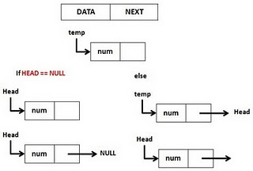
Inserting at the beginning of the List

Slide 24
Code snippet
void addBeg(int num) { struct Node *temp; temp=(struct Node *)malloc(sizeof(struct Node)); temp->Data = num; if (Head == NULL) //If List is Empty { Head=temp; Head->Next=NULL; } else { temp->Next=Head; Head=temp;
}
}

Slide 25
Inserting at the end of the List (Push)
To add a node at the end, we declare two pointers *temp1 and *temp2 then we allocate the base address to temple.
temp1->Data=num means that the number entered by the user (case 2:) is first stored in in temp1 data field.
The base address (head) is then copied to temp2: temp2=Head;
We then test if list is empty (Head==NULL). If true, we make temp1 our list head and the next address pointer to NULL.
If the list is not empty, we Traverse down to end of the list starting from the head since the head base address was copied to temp. Hence the while loop in the code:

Slide 26
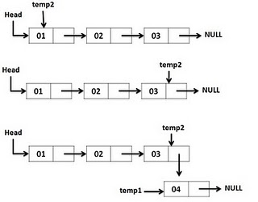
Inserting at the end of the List

Slide 27
Code snippet
if(Head == NULL) { Head=temp1; //If empty create First Node. Head->Next=NULL; } else {// Traverse down to end of the list. while(temp2->Next != NULL) temp2=temp2->Next; // Append at the end of the list. temp1->Next=NULL; temp2->Next=temp1; } }

Slide 28
Inserting Anywhere
The function void addAt(int num, int loc) requires the user to enter the location of the number to be inserted.
For this reason, three pointers are required: A temp pointer, previous and current node addresses.
If we start by assigning cur_ptr to Head, we test if the location entered is greater than the list size or is a negative: if(loc > (length()+1) || loc <= 0)
Note length( ) is a function call within if statement whose implementation in the code is for counting number of elements in the List.

Slide 29
Inserting Anywhere
If the user enters 1, the node becomes the head through addBeg call function
If the user enters any other number !> List length:
The for loop traverses the list and copies current address to previous hence a the previous address is deleted.
Then copied address in previous is made to point to temp (prev_ptr->Next=temp) ;
Then the temp address that was assigned using malloc( ) is pointer is then made to point to current .
Note that temp->Data=num; assigned the entered by the user to temp

Slide 30
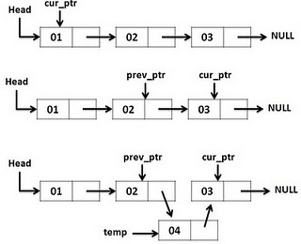
Inserting Anywhere

Slide 31
Code snippet
if (loc == 1) { addBeg(num); }
else {
for(i=1;i<loc;i++) { prev_ptr=cur_ptr; cur_ptr=cur_ptr->Next; } temp=(struct ode *)malloc(sizeof(struct Node)); temp->Data=num;
prev_ptr->Next=temp; temp->Next=cur_ptr; } } }

Slide 32
Deleting a node
The program demonstrates how to delete nodes depending with the location or data in the node.
Lets take the example of the latter.
We start by declaring 2 pointers previous and current and we initialize the current as the head.
The while loop checks if the list is empty. If not, we traverse the list checking if the data entered is the same as the current node data : if(cur_ptr->Data == num) .
If the first node is to be deleted, the next node address becomes the head and the node is deleted: Head=cur_ptr->Next
Otherwise we free the node by copying the current node address to the previous: prev_ptr->Next=cur_ptr->Next; free(cur_ptr);

Slide 33
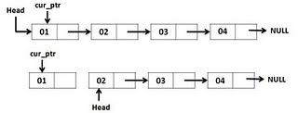
If head is to be deleted

Slide 34
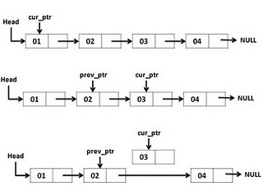
Deleting any other node

Slide 35
Code snippet
cur_ptr=Head; while(cur_ptr != NULL){ if(cur_ptr->Data == num) { if(cur_ptr==Head) { Head=cur_ptr->Next; free(cur_ptr); return 0;} else { prev_ptr->Next=cur_ptr->Next; free(cur_ptr); return 0; } } else{ prev_ptr=cur_ptr; cur_ptr=cur_ptr->Next; } } printf("\nElement %d is not found", num); return 1; }

Slide 36
Applications of linked list
Linked lists are used in the following areas:
1. Polynomial manipulation: this has led to the design of special purpose language to satisfy this need common operations include: addition, subtraction, multiplication and division of polynomials, integration and differentiation.
Software applications that use linked list for polynomial manipulation include; MAPLE,MATLAB,MATHEMATICA.
2.Linked dictionary: this application occurs in many areas such as compiler construction, and information storage retrieval, such information storage retrieval applications include: spellchecker and thesaurus in many word processing application.

Slide 37
Cont’ed
3. Multiple-precision arithmetic: this is concerned with the number of significant digits to be retained in an operation.

